Slide 1
SMART GPS TRACKER USING ARDUINO
REKHA V -19BCE1871

Slide 2
OBJECTIVE
The proposed Arduino based tracking system uses global positioning system and global system using GSM modules. GSM module with a SIM card is used for purpose of communication.
This system can be installed or hidden in your vehicle. After installing the circuit we can easily track the stolen vehicle using a mobile phone. Parents can also use this application to track their children by placing this circuit inside the school/college bag.

Slide 3
BLOCK DIAGRAM:
Cloud :ThingSpeak

Slide 4
MODULES:
GPS: To get the latitude and longitude.
GSM: To receive messages and for communication.
Arduino: Acts as an interface for GPS and GSM.
LCD: To display the co-ordinates.
Connecting to the cloud i.e Thingspeak using cellular data of GSM

Slide 5

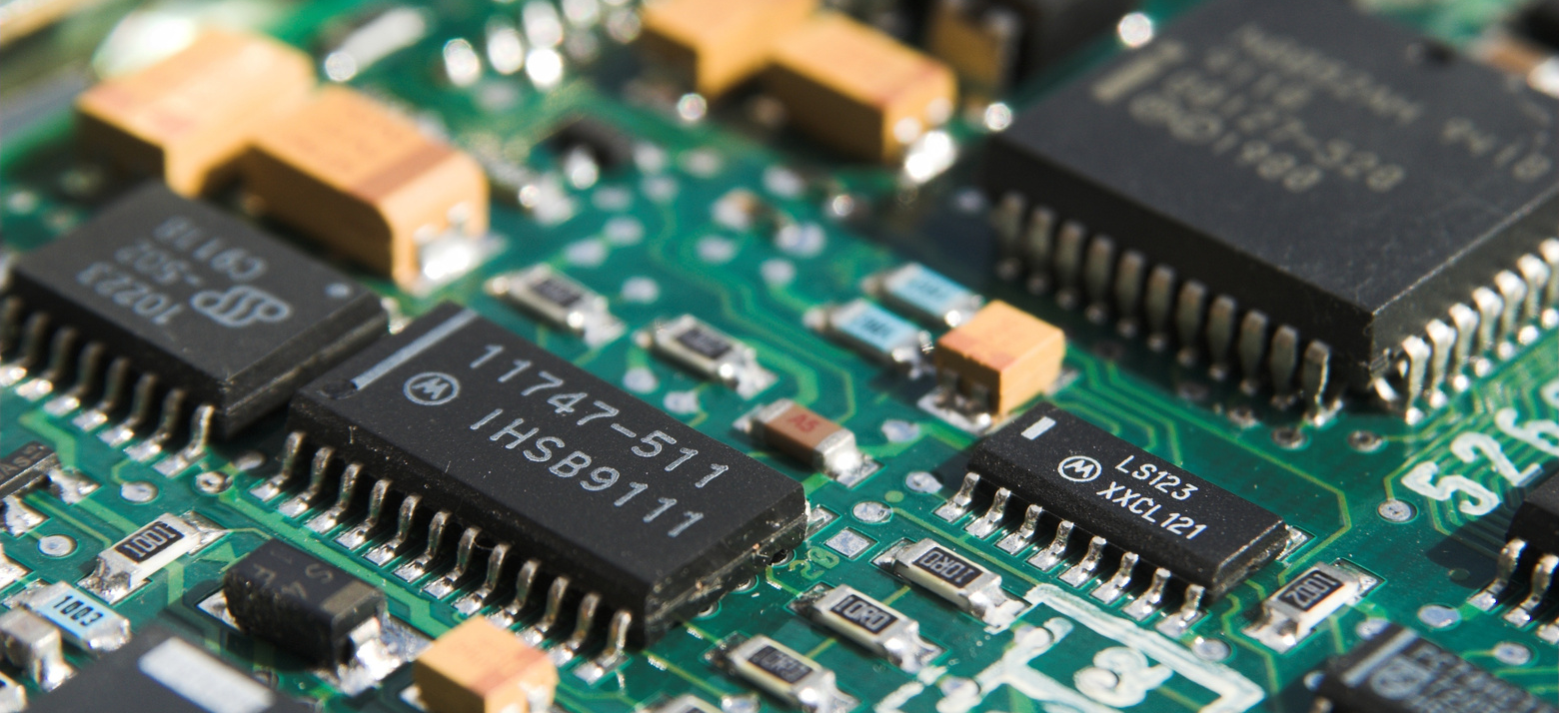
SOFTWARE/HARDWARE SIMULATION:
SOFTWARE SIMULATION TOOL:
Proteus Professional
Arduino UNO
HARDWARE TOOLS:
GPS module
GSM Module
Arduino Uno
Jumper wires and SIM card

Slide 6
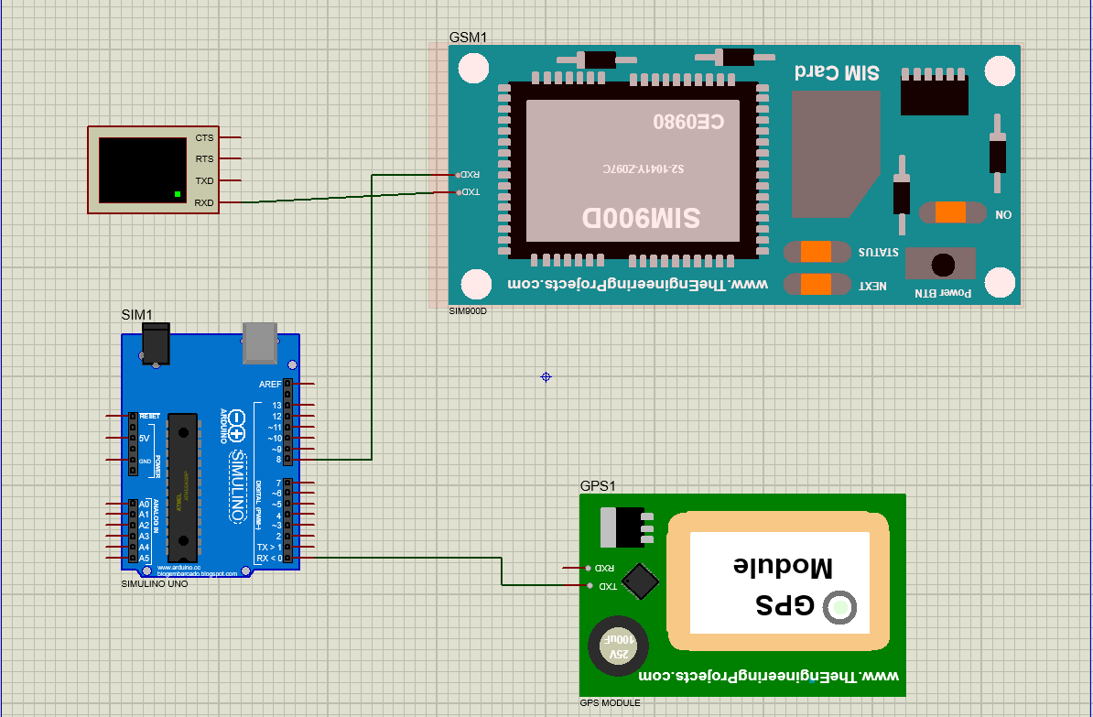
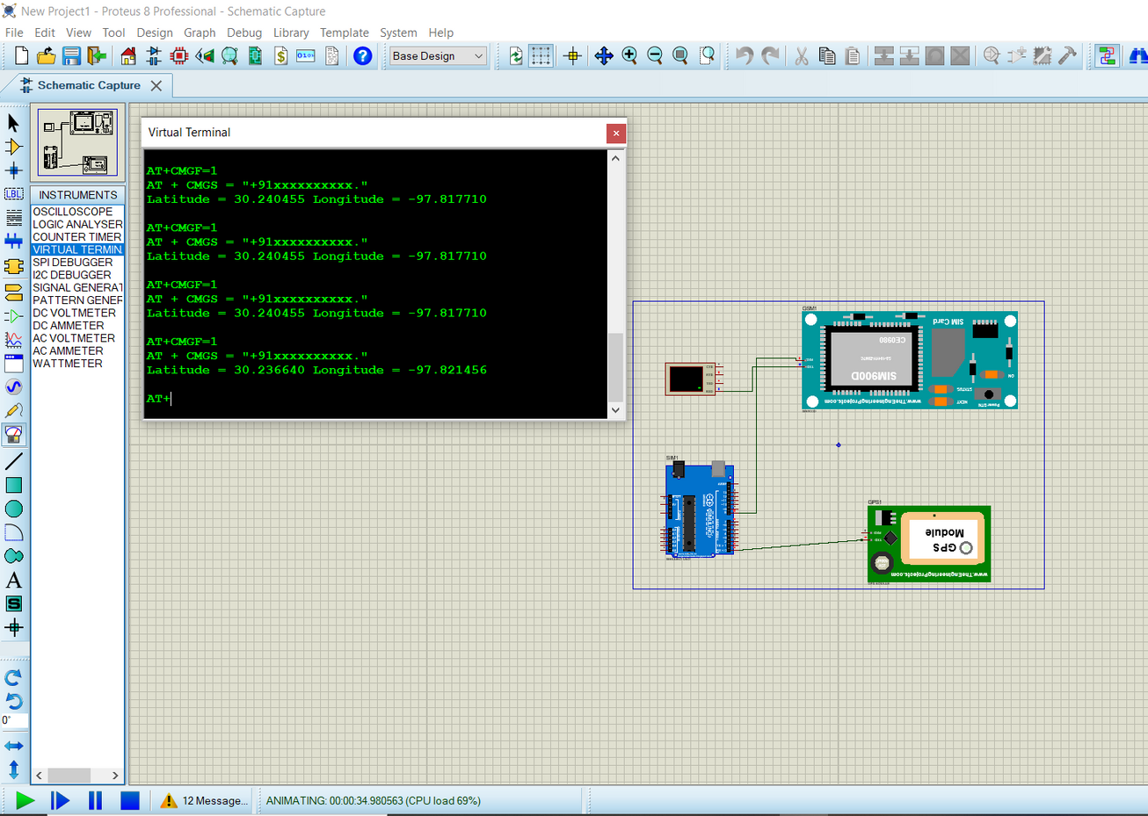
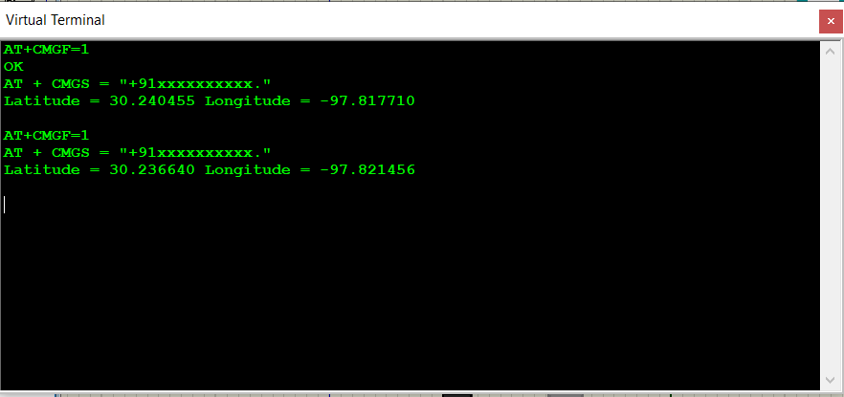
SOFTWARE SIMULATION :
OUTPUT:
Circuit diagram

Slide 7
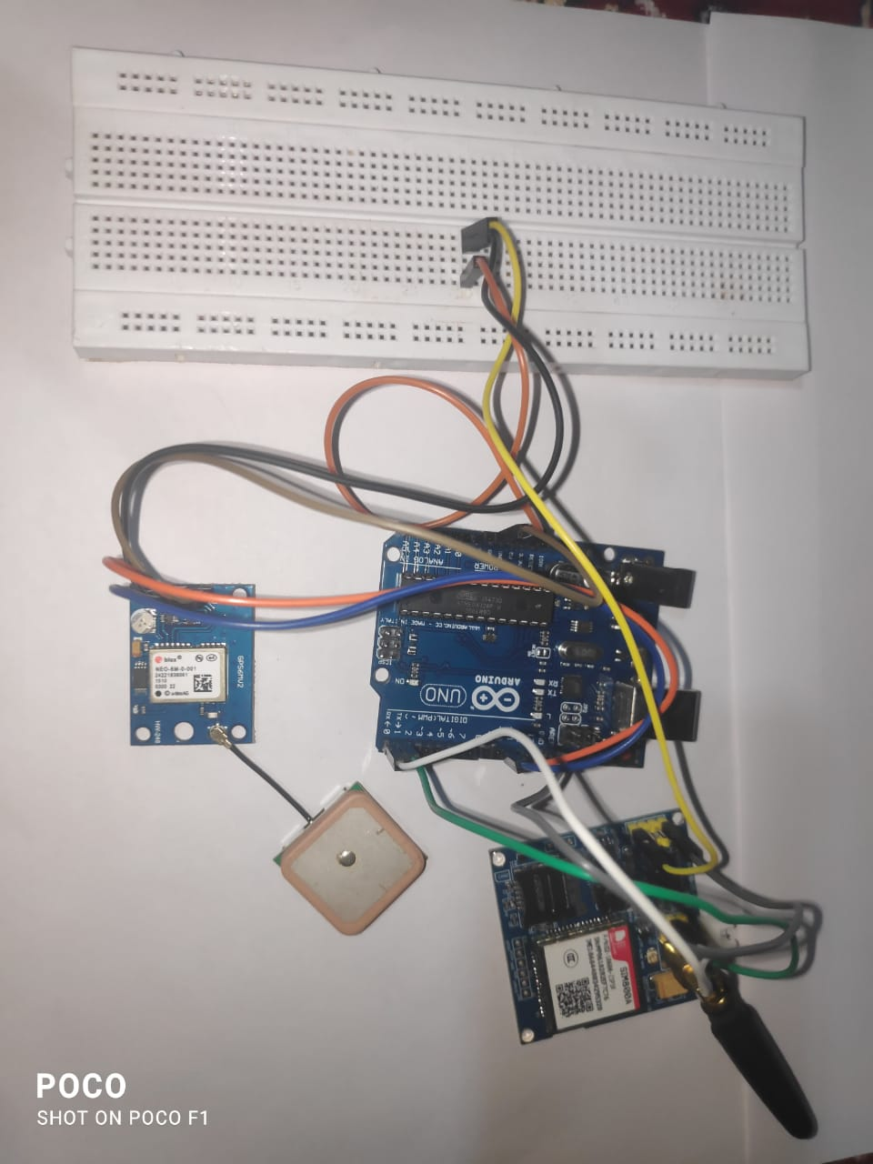
HARWARE Implementation:
Arduino | GPS module
Digital pin 10 | RX pin
Digital pin 11 | TX pin
VCC – 5v | VCC
Ground | Ground
Arduino | GSM module
Digital pin RX | TX pin
Digital pin TX | RX pin
VCC – 5v | VCC
Ground | Ground

Slide 8
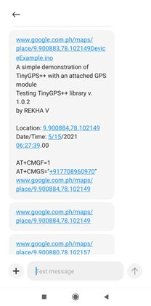
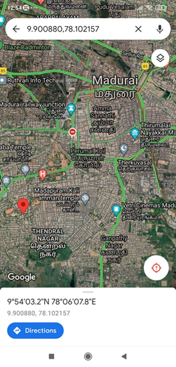
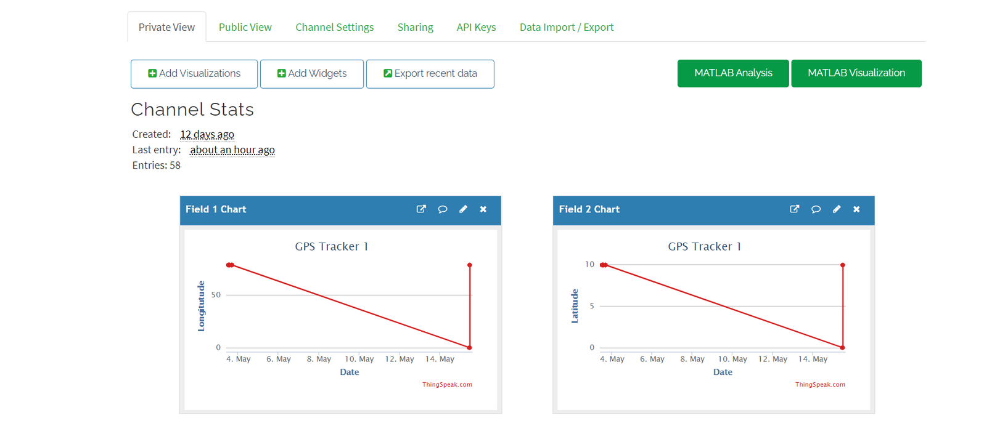
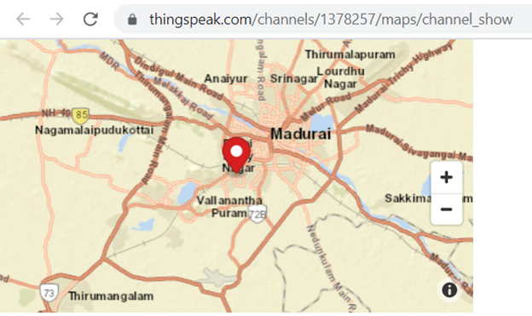
OUTPUT FROM HARDWARE IMPLEMENTATION:

Slide 9

IMPLEMENTATION OF THE PROJECT:

Slide 10
THANK YOU
TEAM NAME: FRANCE

